Slide 1
Fraud Detection
By Bolarinwa oreoluwa seun

Slide 2
content
ABOUT
Procedures
Data analysis ,data wrangling and data manipulation
Data visualization
Machine learning modelling
Testing

Slide 3
About

Slide 4

What this project is about.
A machine learning model that predicts whether a transaction is fraudulent or not based on several features of a given data set.
In this project, a fraudulent transaction outputs the value 1, and a non fraudulent transaction outputs the value 0.

Slide 5
Procedures

Slide 6

Data analysis , wrangling and manipulation.
Definitions
Data analysis - the process of cleaning, analyzing, interpreting, and visualizing data to discover valuable insights that drive smarter and more effective business decisions. Data analysis tools are used to extract useful information from business data, and help make the data analysis process easier.

Slide 7
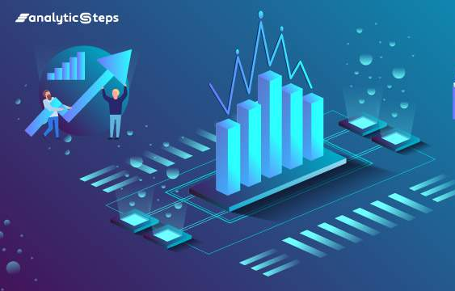
Data analysis , wrangling and manipulation.
Data wrangling, sometimes referred to as data munging, is the process of transforming and mapping data from one "raw" data form into another format with the intent of making it more appropriate and valuable for a variety of downstream purposes such as analytics.
Data manipulation refers to the process of adjusting data to make it organised and easier to read.

Slide 8
DATA ANALYSIS,WRANGLING AND MANIPULATION
IN THIS SECTION:
I performed various and numerous analytical , wrangling and manipulation activities on my dataset to keep it in the best possible format for efficient usage
I GAINED SOME INSIGHTS ON the dataset using some data visualization tools and this will be dwelt upon shortly.

Slide 9
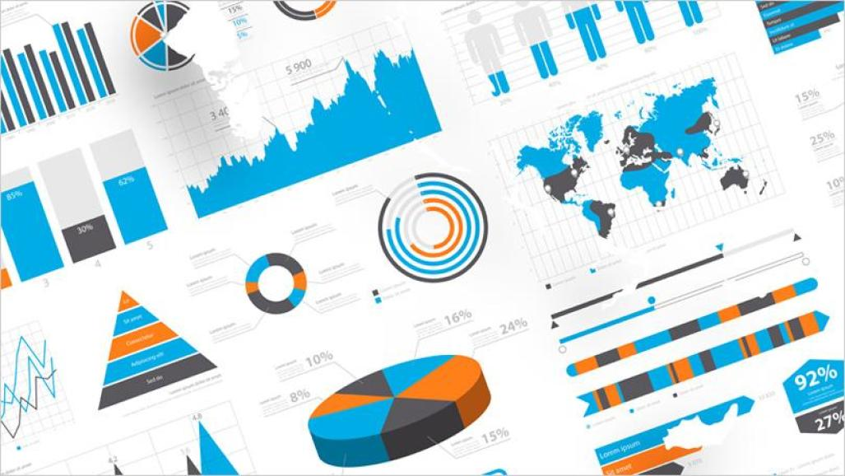
DATA VISUALIZATION
Data visualization is the graphical representation of information and data. By using visual elements like charts, graphs, and maps, data visualization tools provide an accessible way to see and understand trends, outliers, and patterns in data.
The main idea behind all the data visualizations is to give insights on the data…

Slide 10
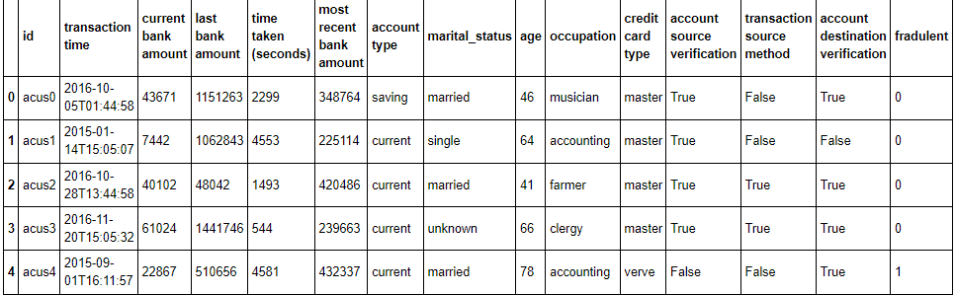
An overview of the dataset used.

Slide 11
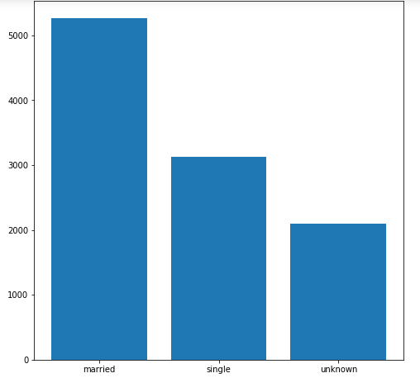
Data visualization.
Here is a bar chart representation of the ‘marital_status’ feature of the dataset..
As we can see.. The ‘married’ are way greater than the ‘single’ and the ‘unknown’.
We move a step further to gain more insights from this data feature.

Slide 12
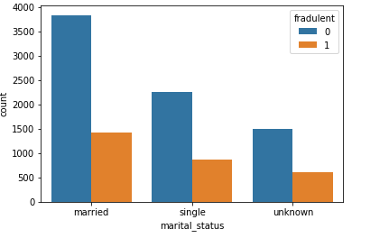
Data Visualization.
Here a count plot is made
This plot shows us how many people of status “married” , ‘single’ , and ‘unknown’ fell victims of fraudulent activities or not.. Where fraudulent means 1 and non fraudulent , 0
About 1500 out of 5270 married people fell victims of fraud.
Also about 1500 out of 5223 unmarried people fell victims of fraud

Slide 13
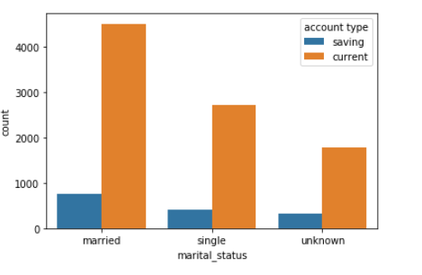
Data visualization
This count plot shows us the number of married and unmarried people that make use of either savings or current account type.

Slide 14
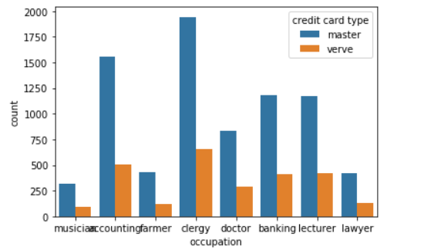
Data visualization
This count plot shows us the number of people in different occupations that makes use of either master or verve credit card

Slide 15
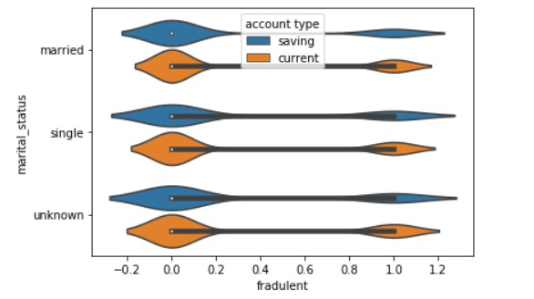
Data visualization.
Here is a violin plot between the target variable and the marital_status feature in relation to the account_type feature.

Slide 16
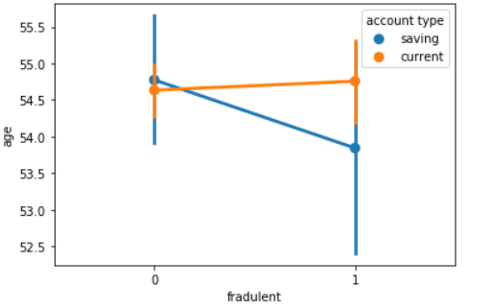
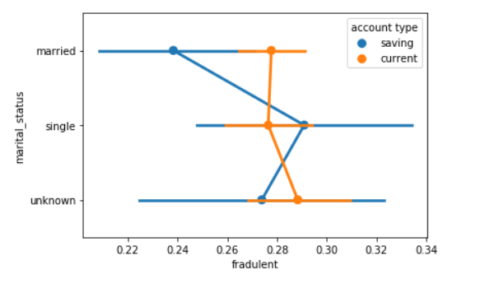
Data visualization

Slide 17
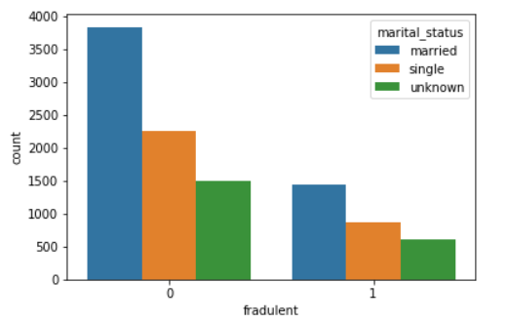
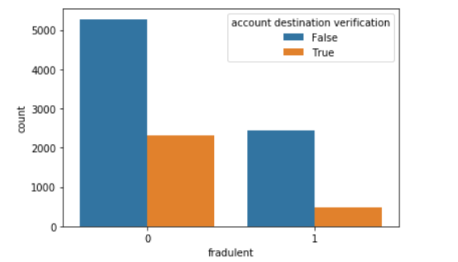
Data visualization

Slide 18
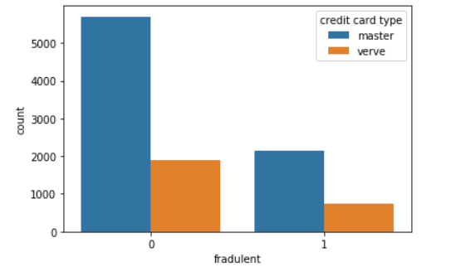
DATA VISUALIZATION
many more visualizations can always be done to get insights from the datasets
Here is one more

Slide 19
Data visualization tools
Data visualization tools include
Matplotlib
Seaborn
pyplot

Slide 20
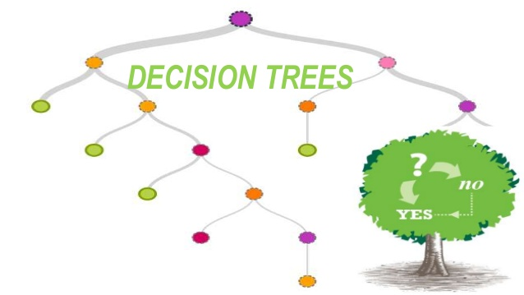
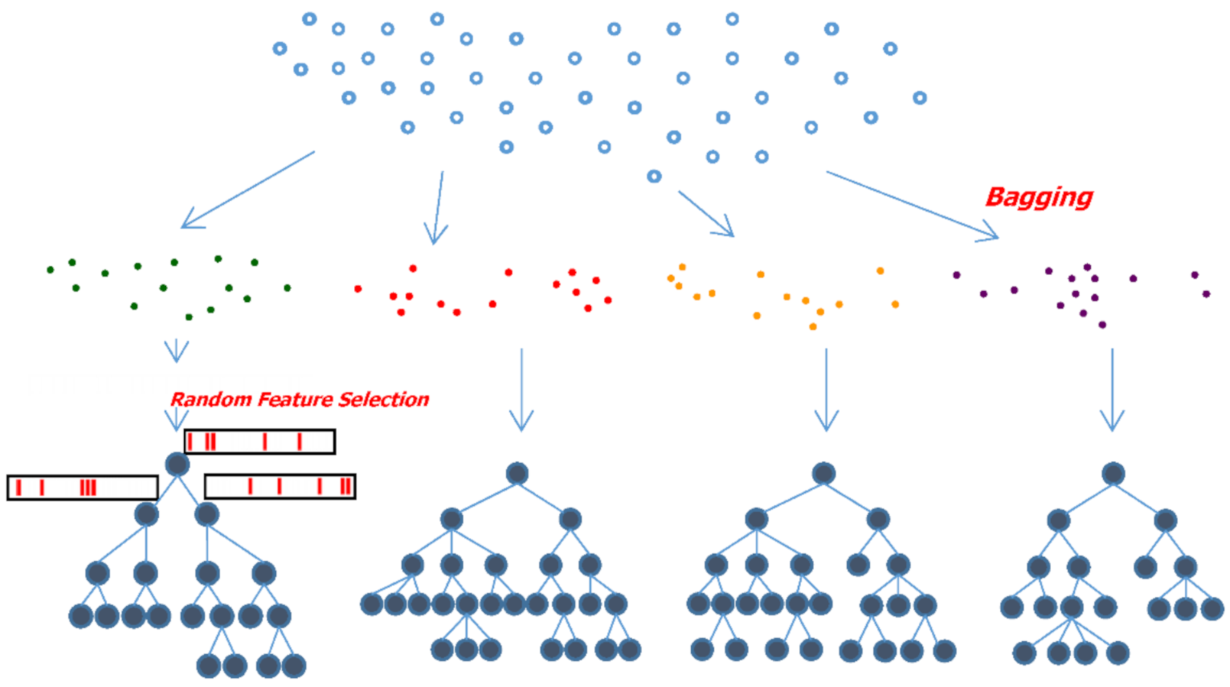
Machine learning modelling.

Slide 21
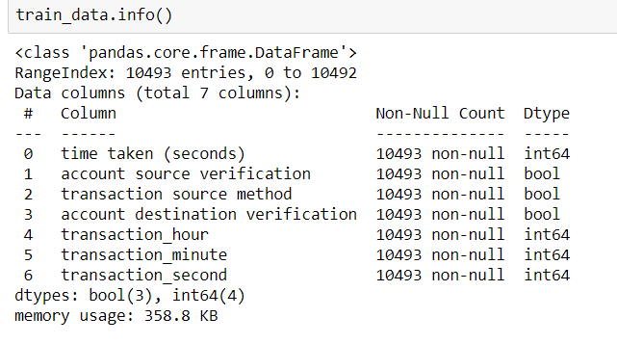
Machine learning modelling.
I performed feature engineering on the datasets, removed un-needed data features and created new ones
Eventually my original datasets reduced to only this features by the right

Slide 22
Machine learning modelling
From sklearn, a machine learning framework I imported logistic regression , random forest regressor and decision tree regressor
I fitted the train dataset with the different machine learning algorithms
Then I approached the testing phase

Slide 23
Testing.

Slide 24
Testing
After creating the different machine learning models… I achieved an accuracy of about 72% for the logistic regression model, about 89% for the random forest model and a accuracy of 100% for the decision trees model..
Hence taking the model with the highest accuracy… the decision tress model is used in detecting fraud.

